Slide 1
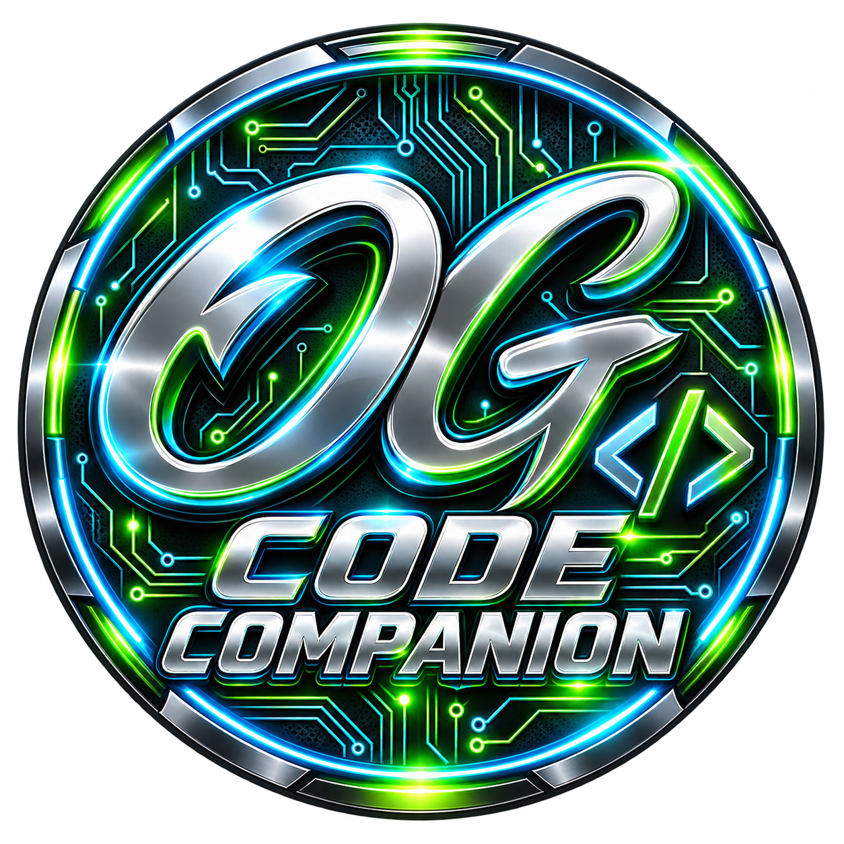
OG WEB.SITE
OG Companion
Product and technical portfolio
A desktop workbench for library discovery, public code examples and editable program foundations.
Rob Johnston | Source evidence: 14 October 2026
Notes:
Sources: OG Companion 2.2 source modules and tests; content-inventory.json; supplied OG logo and ICO; Windows executable and controlled local-model verification, 14 October 2026. https://github.com/OG-Website/OG-Code-Companion-

Slide 2
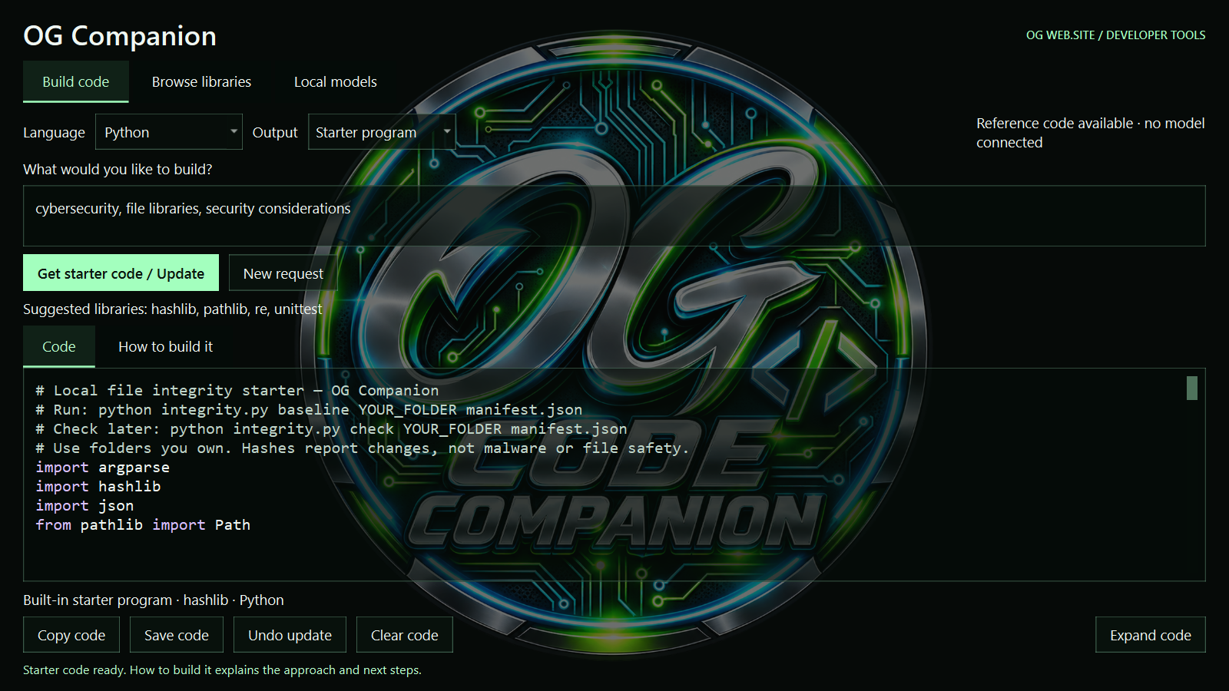
The coding workbench
Build code accepts a program idea and returns editable source with guidance.
Browse libraries and Local models have their own tabs. Connect a model explicitly, or use supplied and retrieved examples without AI.
OG Companion | Product and technical | 14/10/2026
02
Notes:
Sources: OG Companion 2.2 source modules and tests; content-inventory.json; supplied OG logo and ICO; Windows executable and controlled local-model verification, 14 October 2026. https://github.com/OG-Website/OG-Code-Companion-

Slide 3
Application architecture
Desktop interface
og_companion.py coordinates three Qt tabs, background workers and the editable source. Startup fits the display work area and remembers the chosen monitor.
Discovery and generation
og_companion_search.py handles task matching and registries. It discovers recipient model services and validates Python responses before display.
Documentation and source retrieval
og_companion_sources.py retrieves public HTTPS text, extracts code blocks and supports full collections with per-collection deduplication.
Local resources
The catalogue and supplied assets sit beside the executable. Caches and service URLs belong to each user. Model weights remain separate.
OG Companion | Product and technical | 14/10/2026
03
Notes:
Sources: OG Companion 2.2 source modules and tests; content-inventory.json; supplied OG logo and ICO; Windows executable and controlled local-model verification, 14 October 2026. https://github.com/OG-Website/OG-Code-Companion-

Slide 4
Content scope
Discovery
22 language/tool choices, including CMake. Seven registry adapters directly cover 11 choices; other routes use documentation and public source discovery.
Documentation catalogue
244 collection titles across 837 published editions. These are versions and documentation sets, rather than 837 unique libraries.
Included material
31 teaching snippets across 14 languages, two Python foundations and 14 licensed example collections.
Measured source blocks
The 14 supplied collections contain 84,512 summed blocks. The sum is per collection, includes configuration/transcripts and is not a count of runnable programs.
OG Companion | Product and technical | 14/10/2026
04
Notes:
Sources: OG Companion 2.2 source modules and tests; content-inventory.json; supplied OG logo and ICO; Windows executable and controlled local-model verification, 14 October 2026. https://github.com/OG-Website/OG-Code-Companion-

Slide 5
Operating evidence and limits
Current source
106 automated checks passed on 14/10/2026. The packaged executable loads both foundations, three tabs, clearing and undo.
Branding
The original PNG and ICO remain intact. A smoothly scaled circle forms the background, with softer contrast and readable code colours.
Current release
The Windows 2.2 executable runs from the canonical application folder. Its native visible frame fits screen 3, including the title bar.
Outstanding verification
The interface was inspected at 1280 x 720 and 960 x 700 logical sizes. A clean second computer and live LM Studio installation remain separate checks.
OG Companion | Product and technical | 14/10/2026
05
Notes:
Sources: OG Companion 2.2 source modules and tests; content-inventory.json; supplied OG logo and ICO; Windows executable and controlled local-model verification, 14 October 2026. https://github.com/OG-Website/OG-Code-Companion-

Slide 6
Development and use boundaries
Custom program drafts
Custom drafts use a connected Ollama, LM Studio or compatible local service. One qwen2.5:3b module passed controlled file-count and missing-folder tests.
Public reference content
Sources retain URLs and attribution. The app fetches public HTTPS text and rejects local/private source destinations; it does not run retrieved code.
Code ownership
The OG application and brand are distinct from third-party reference examples. Their supplied source-licence files remain with the collections.
Distribution
The Windows ZIP includes its runtime, assets and examples. Recipient acceptance and broader provider checks remain distinct from local build evidence.
OG Companion | Product and technical | 14/10/2026
06
Notes:
Sources: OG Companion 2.2 source modules and tests; content-inventory.json; supplied OG logo and ICO; Windows executable and controlled local-model verification, 14 October 2026. https://github.com/OG-Website/OG-Code-Companion-

